Slide 1

Gender Classification in Retail: Leveraging CNNs with Azure Custom Vision
Enhancing Customer Insights through Advanced Image Classification

Slide 2
Introduction and Importance
Objective: Utilize CNNs to classify customer gender from photographs to tailor retail marketing.
Need for Gender Classification:
Essential for personalized customer interactions and marketing.
Advances in image recognition have surpassed 98% accuracy, enhancing reliability in customer identification.

Slide 3
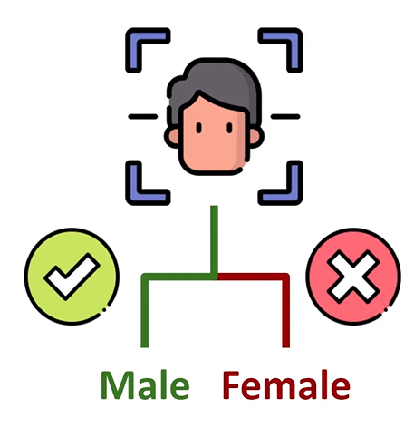
Project Scope and Problem Statement
Problem Statement: Difficulty in accurately identifying customer gender limits effective marketing strategies.
Scope:
Develop and deploy a gender classification system using Azure Custom Vision.
Apply CNNs to recognize and classify gender from diverse customer images.

Slide 4
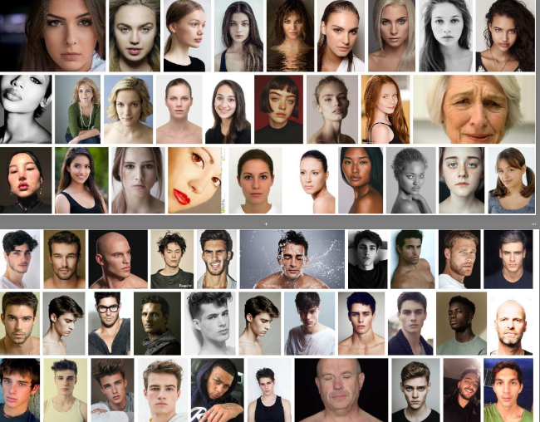
Data and Model Training
Dataset: Sourced from Kaggle, comprising diverse images labeled by gender.
Link: https://www.kaggle.com/datasets/gpiosenka/gender-classification-from-an-image
The dataset consist of 962 male images and 727 female images.
Training Process:
Iterative approach to adjust model parameters based on training data.
Focus on maximizing accuracy, precision, and recall to ensure robust performance.

Slide 5
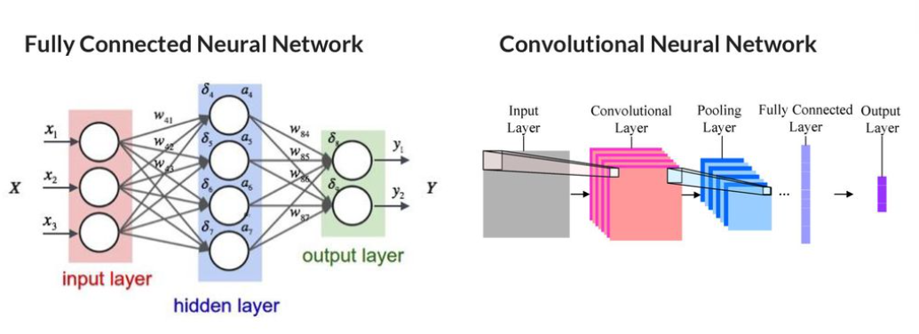
Neural Network and Model Architecture

Slide 6

Evaluation and Deployment
Accuracy to measure overall correctness. Precision and recall to assess model reliability in identifying gender.
Integrated into retail environments for real-time classification. Capable of handling inputs from various sources, including in-store cameras.
Video demonstration of the image classification gender prediction process using Microsoft Azure Custom Vision: link

Slide 7

Conclusion and Future Directions
Successful development of a gender classification model leveraging advanced CNNs in Azure Custom Vision
Expand the dataset and refine the model to improve accuracy and applicability across different retail setting

Slide 8

Thank You
Chandra shekar Ankishetty
Naveen Datanagari
Sishira ITIGANI
Chakradhara Nalla

